Slide 1

Research and Innovation: Iteration 1
Baian Khanjar, Andy Lin, Celeste Menard, Sohal Patel, Ruomei Wang, Emily Wantland
Added Value Group

Slide 2
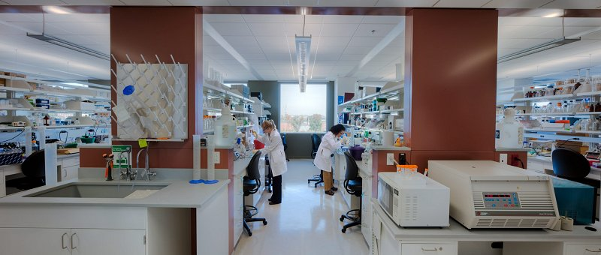
What We’ll Cover...
Business Needs
Increasing revenue
Streamlining the application process
Making navigation easier
Business Requirements
Connecting researchers to funding
Connecting industry partners to research opportunities
Business Value
Each project will bring in upwards of 40% of the overall cost

Slide 3
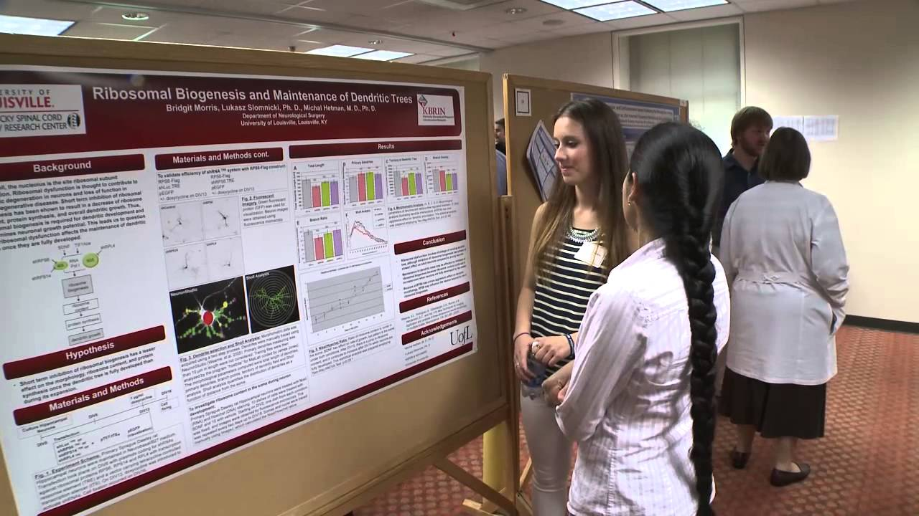
Funding Constraints
Problems with funding right now:
The website is constraining the ability to make money
The inability to effectively navigate the website makes it difficult to connect industry partners to funding opportunities

Slide 4
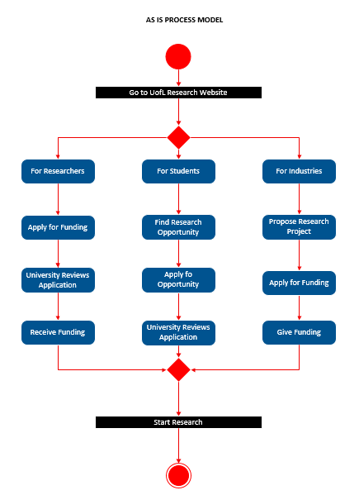
Website Navigation
When navigating the website, it was difficult to find the research application page.
For students it takes 2 clicks
For researchers it takes 4 clicks
For industry partners it takes 5 clicks and brings you to a new website that you also need to navigate

Slide 5
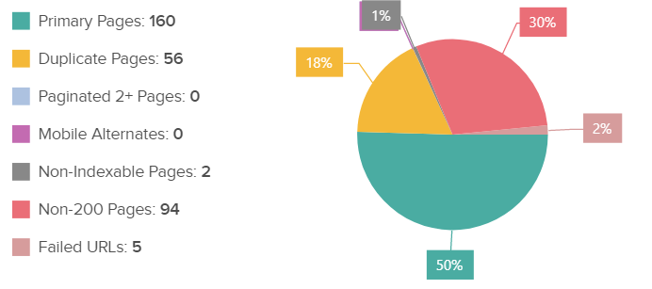
There are 160 primary pages and 56 duplicate pages

Slide 6

Public Engagement
The university highlights completed research projects via newsletter, many can’t find it
Achievements are difficult to find
Measures of excellence are not highlighted
The newsletter needs improvement

Slide 7
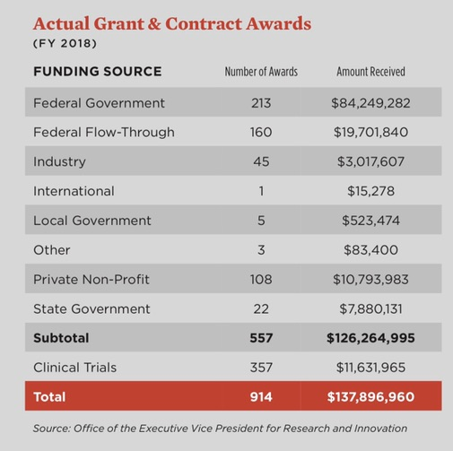
Revenue After Changes
Average Grant: 15,000,000
Notes:
Revenue from 40% of 10 grants: $60,000,000
Revenue from 40% of 2 grants: $12,000,000
Revenue from 40% of 5 grants: $30,000,000

Slide 8
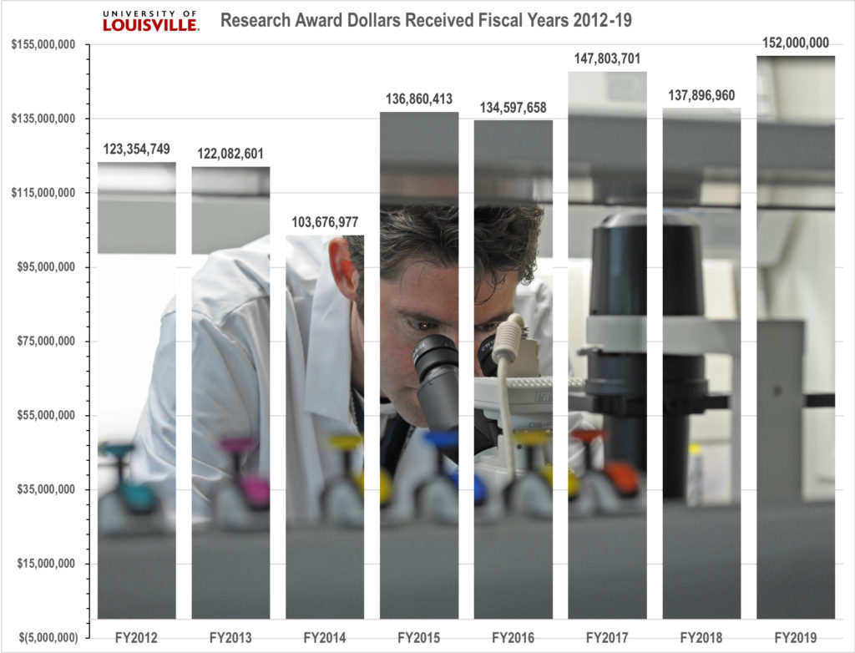

Slide 9

Summary
Process Problems
Funding Constraints
Website Navigation
Public Engagement
Revenue
40% off the top

Slide 10
Questions?

